Slide 1

OBJECT ORIENTED PROGRAMMING SYSTEM
Blood Bank Inventory & Donor Matcher
A Centralized Management Platform for Real-Time Stock Tracking & Compatible Donor Coordination
PROJECT TEAM MEMBERS
Vikas Chinta
M Vinay
Harivansh
Date
Roll No: 2620030391
Roll No: 2620030387
Roll No: 2620040183
15-09-2026

Slide 2

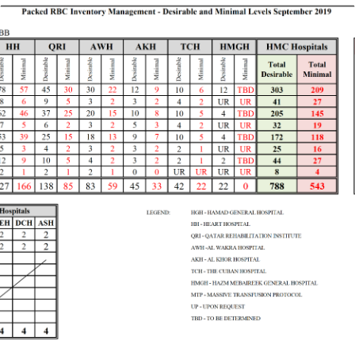
Project Abstract
System Overview
The Blood Bank Inventory & Donor Matcher is a proposed system designed to improve blood stock management and help connect blood banks with potential donors. Manual recordkeeping can lead to delays in locating blood units, inaccurate inventory records, and wastage due to expiry. This system aims to address these challenges through a centralized platform for managing blood inventory, donor information, and blood requests.
The system tracks blood units by blood group, quantity, collection date, and expiry date, enabling staff to monitor availability and prioritize units approaching expiration. The donor matching feature identifies potential donors based on blood group, location, availability, and recorded donation history. Low-stock alerts and request tracking support timely coordination between blood banks, hospitals, and donors. Donor eligibility and transfusion compatibility remain subject to clinical screening and laboratory testing.
By reducing administrative effort and improving access to accurate information, the proposed system aims to minimize blood wastage, support donor coordination, and assist in the timely fulfillment of routine and emergency blood requests.
Blood Bank Inventory & Donor Matcher
Slide 2

Slide 3


Understanding Problem Statement
Operational Challenges
Manual Record Inaccuracies
Paper logs lead to inaccurate inventory counts, unrecorded dispatches, and unexpected stock shortages during urgent requirements.
Delayed Emergency Response
Locating specific blood types or contacting suitable donors manually consumes critical time during medical emergencies.
Wastage & Unmonitored Expiry
Lack of structured tracking prevents staff from prioritizing units nearing expiration, resulting in preventable blood wastage.
Blood Bank Inventory & Donor Matcher
Slide 3

Slide 4
CO 1 Topics: Data Types & Operators
Java Fundamentals
Data Types Implementation
Operators Application
Primitive Types (int): Used for quantitative metrics such as donor age, unit quantities, and choice selections.
Compound Arithmetic (+=, -=): Manages inventory additions and updates unit deductions during issuance.
Reference Types (String): Handles textual donor credentials including names, blood group symbols, and phone contacts.
Relational Operators (<, >, ==): Enforces eligibility age limits (18–65 years) and verifies stock thresholds.
Boolean Flags: Evaluates dynamic system states during compatibility searches and record matches.
Logical Operators (||, !): Combines multi-variable conditions for input validation and availability status.
Custom Objects (Donor Class): Encapsulates multi-attribute entity structures into cohesive data objects.
Assignment & Decrement: Tracks live iteration indexes and updates database state dynamically.
Blood Bank Inventory & Donor Matcher
Slide 4

Slide 5
CO 2 Topics: Control Structures & Loops
Program Flow
If-Else Logic
Switch Case Structure
Do-While & For Loops
Evaluates donor eligibility rules (restricting age between 18 and 65) and validates if current stock levels can fulfill pending patient requisitions.
Drives main application menu operations and maps specific blood groups (A+, B-, O+, etc.) to their universal donor/recipient compatibility matrix.
Do-While: Keeps console menu active continuously.
For-Each: Traverses donor registries & stock arrays efficiently.
Nested Loops in Donor Matching
In inventory shortage scenarios, nested iteration evaluates registered donors against array lists of compatible blood groups, displaying matches immediately.
Blood Bank Inventory & Donor Matcher
Slide 5

Slide 6
CO 3 Topics: Methods & Arrays
Modular Architecture
Arrays & Dynamic Collections
Modular Method Abstraction
Fixed Stock Arrays: Parallel array indexing maps 8 standard blood group strings to integer inventory totals.
Functional Decomposition: Tasks partitioned into specific methods (addDonor, issueBlood, viewInventory).
Dynamic ArrayList: Resizable Object list handles unpredictable donor registrations without predefined size bounds.
Reusable Helpers: Input validation (readValidBloodGroup) encapsulates repetitive error checks cleanly.
Lookup Mapping: Array helper functions return string arrays of compatible blood types dynamically.
Encapsulated Logic: Display methods inside Donor class print formatting consistently.
Blood Bank Inventory & Donor Matcher
Slide 6

Slide 7


Geo Tag Photo and Git Hub Link
Verification
Geo Tag Photo Placeholder
GitHub Repository Link Placeholder
Blood Bank Inventory & Donor Matcher
Slide 7

